Slide 1
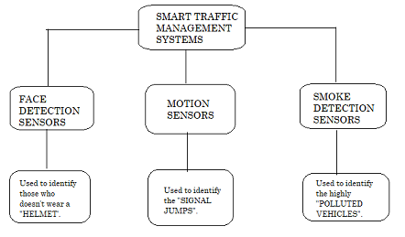
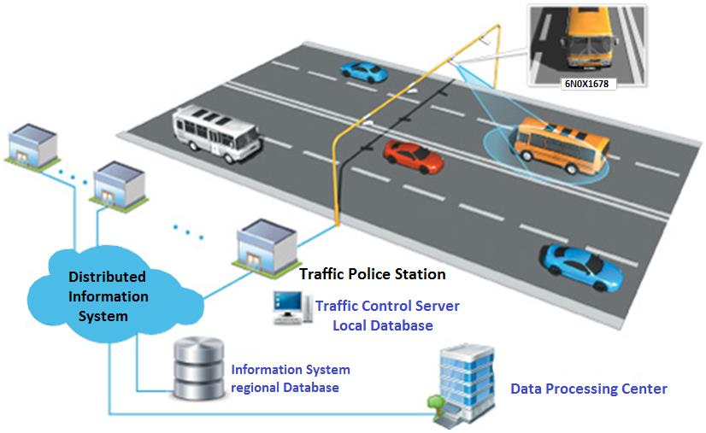
SMART TRAFFIC MANAGEMENT SYSTEMS
Traffic management system is a conerstone of a smart city.In the current problems of the world,urban mobility is one of the major problems,especially in metropolitan cities.The pupose of this paper is to propose a smart traffic management system using internet of things and a decentralized approach to optimize traffic on the roads and intelligent algorithms to manage all traffic situations more accurately.For this,we propose a new smart traffic management system with the help of sensors, through this we can identify those who violate the traffic rules such as: not wearing a helmet,signal jumps and polluted vehicles.
It helps in reducing the manual-power.
Motorcycle riders will be cautious about wearing a helmet while driving.
There would be a control on pollution which results eco-friendly traffic system.
Team members:
V.Sathwika Reddy
P.Rahul Reddy
G.Aishwarya
Mentor:
D.Deepthi sri
Team Name:VANIQUISHERS

